Slide 1
self avoiding random walks
Michail Tagaris

Slide 2
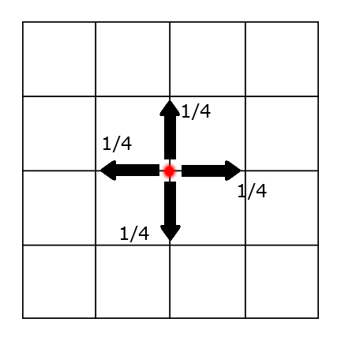
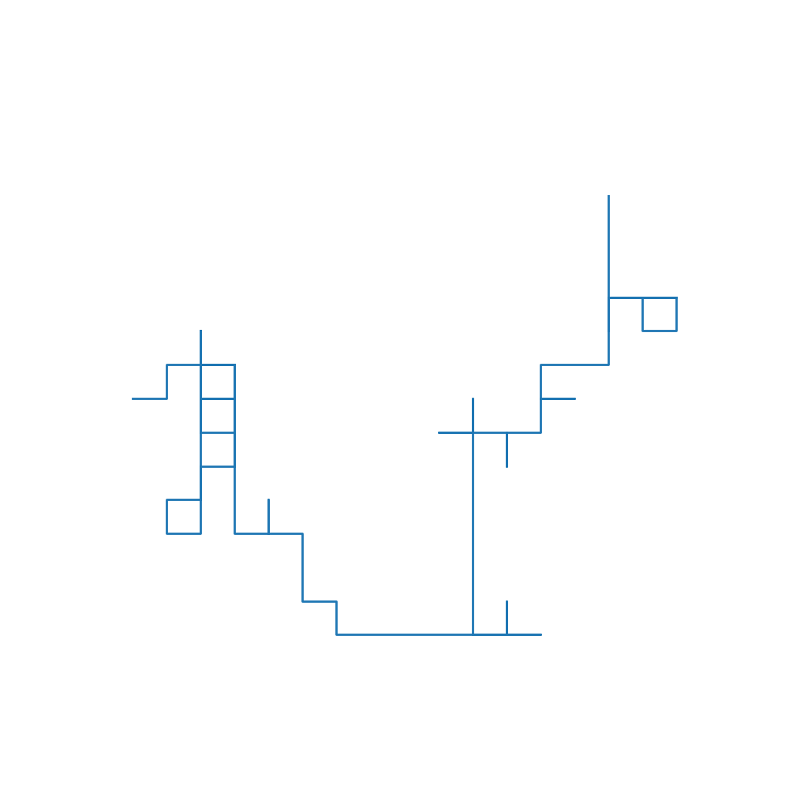
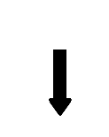
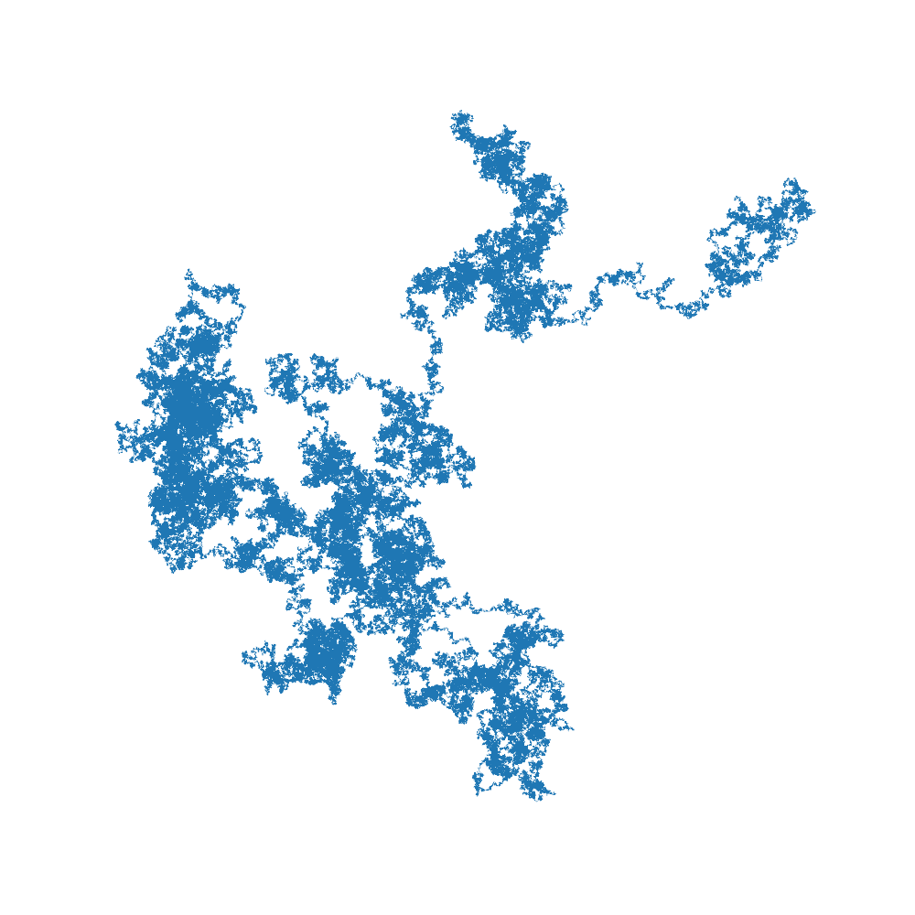
(Simple) Random Walks
(On a d-dimensional square lattice) On each node, it has a (1/2d) probability to go to each of his nearest neighbors.
Each step it takes, is independent of every previous step that happened (Markov property)
On the limit that the distance between the lattice points becomes very small and at the same time after a high number of steps (scaling limit) the random walk turns into Brownian motion
It’s basically a measure that shows us how the random walk expands.

Slide 3
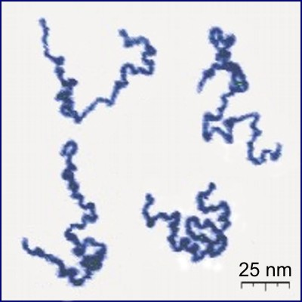
Self Avoiding Random Walks
They are random walks that have the restriction of being able to go only on free lattice points (not being able to go to a previously occupied site).
Obviously they don’t fulfill the Markov property because they always retain memory of their previous steps.
In nature we can encounter them in the form of polymer macromolecules.

Slide 4
What are we studying
What are the critical exponents of the self avoiding walk
How do they behave in regards to the dimension (d)of the lattice.
What is (if it exists) the scaling limit

Slide 5
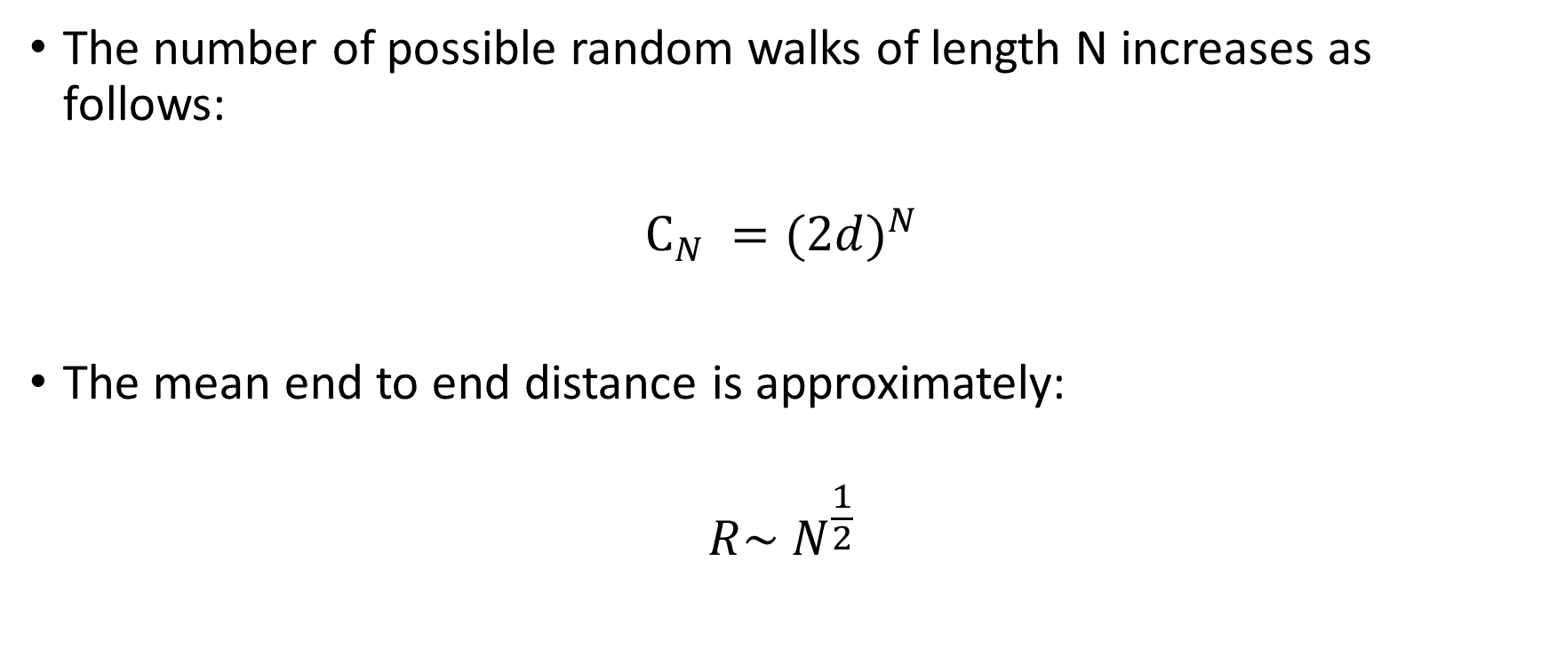
(Simple) Random Walks
The number of possible random walks of length N increases as follows:
$$C_{N} ={(2d)}^{N}$$
The mean end to end distance is approximately:
$${R\sim N}^{\frac{1}{2}}$$

Slide 6
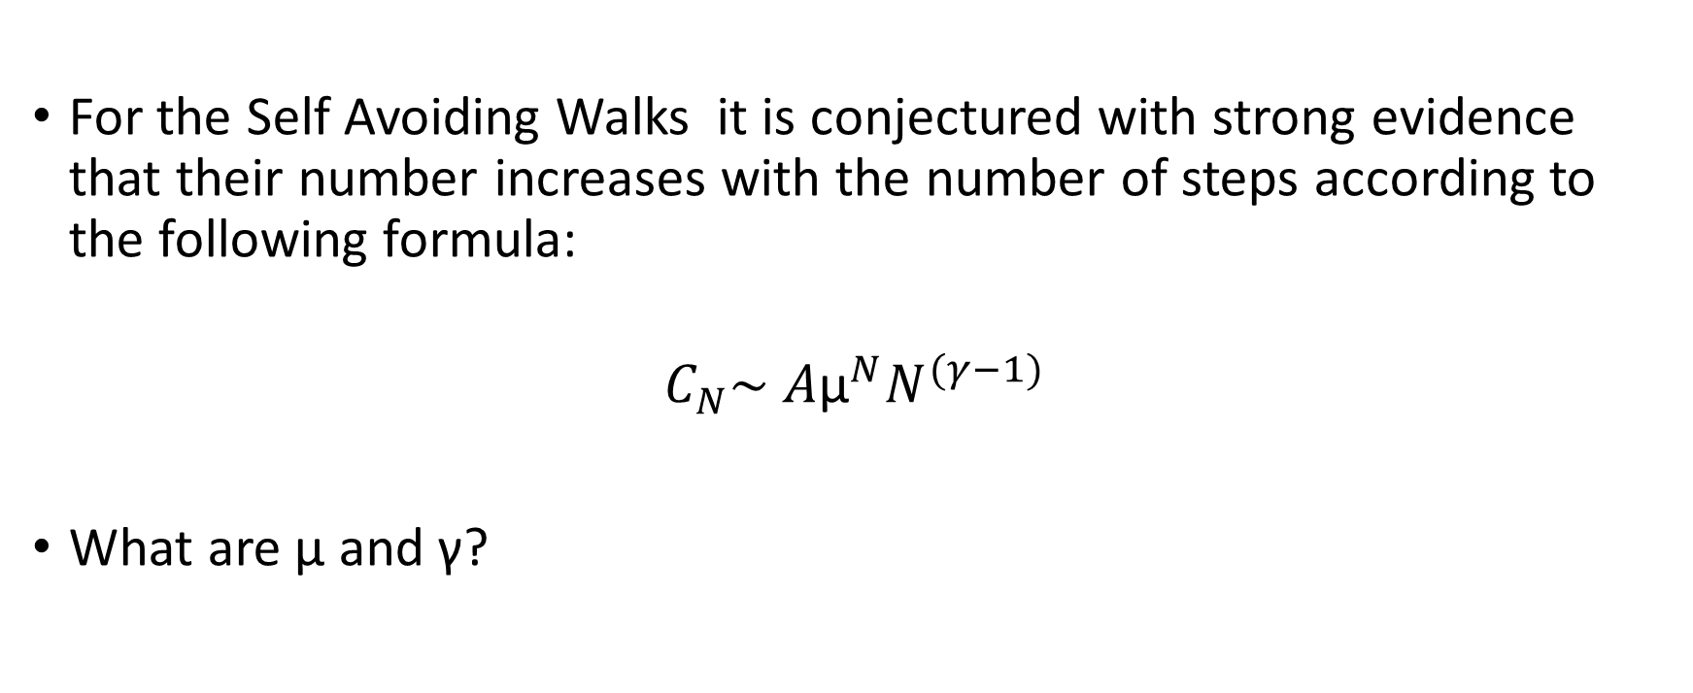
Self Avoiding Walks
For the Self Avoiding Walks it is conjectured with strong evidence that their number increases with the number of steps according to the following formula:
$$C_{N}\sim A{\text{μ}}^{N}N^{(γ−1)}$$
What are μ and γ?

Slide 7
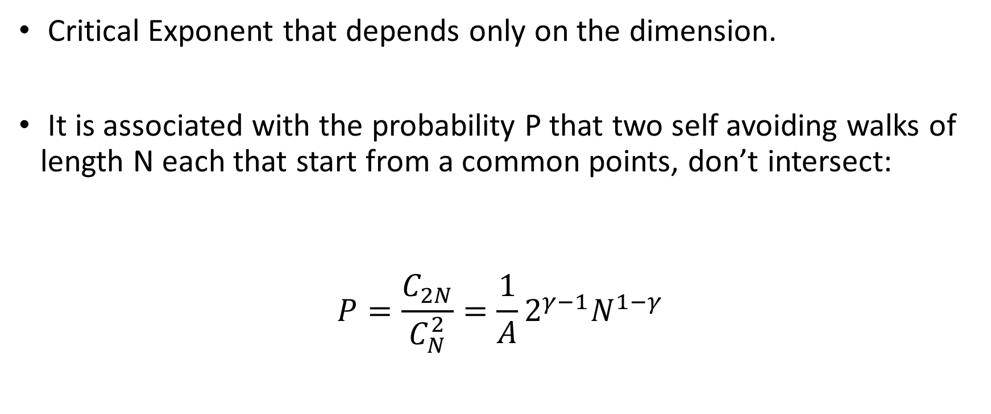
What is γ
Critical Exponent that depends only on the dimension.
It is associated with the probability P that two self avoiding walks of length N each that start from a common points, don’t intersect:
$$P=\frac{C_{2N}}{C_{N}^{2}}=\frac{1}{A}2^{γ−1}N^{1−γ}$$

Slide 8
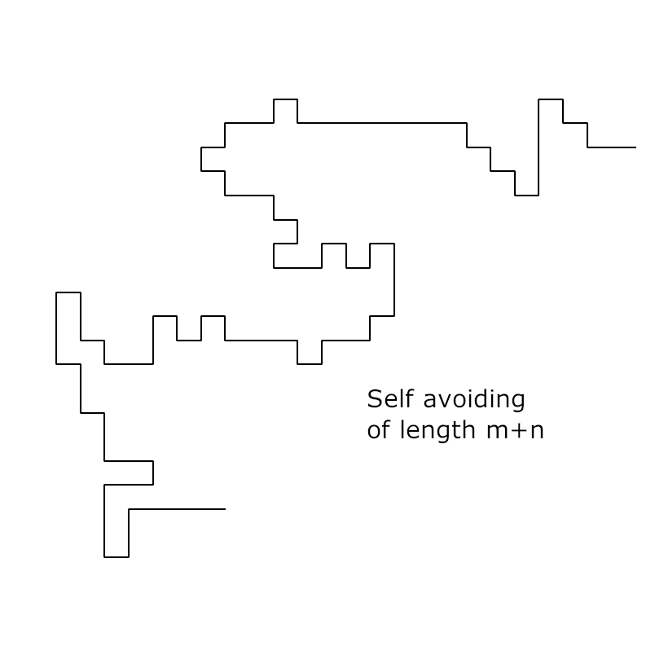
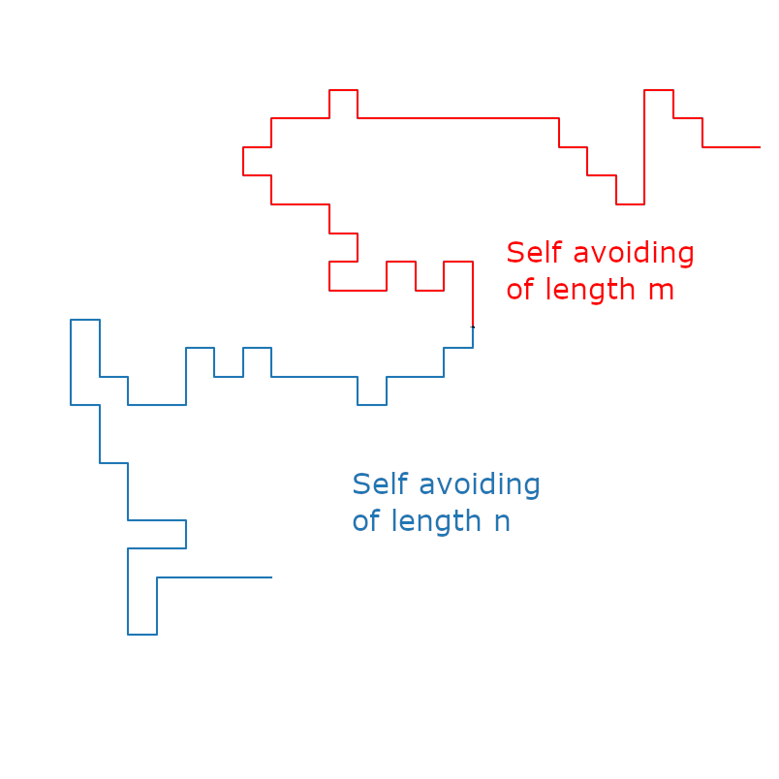
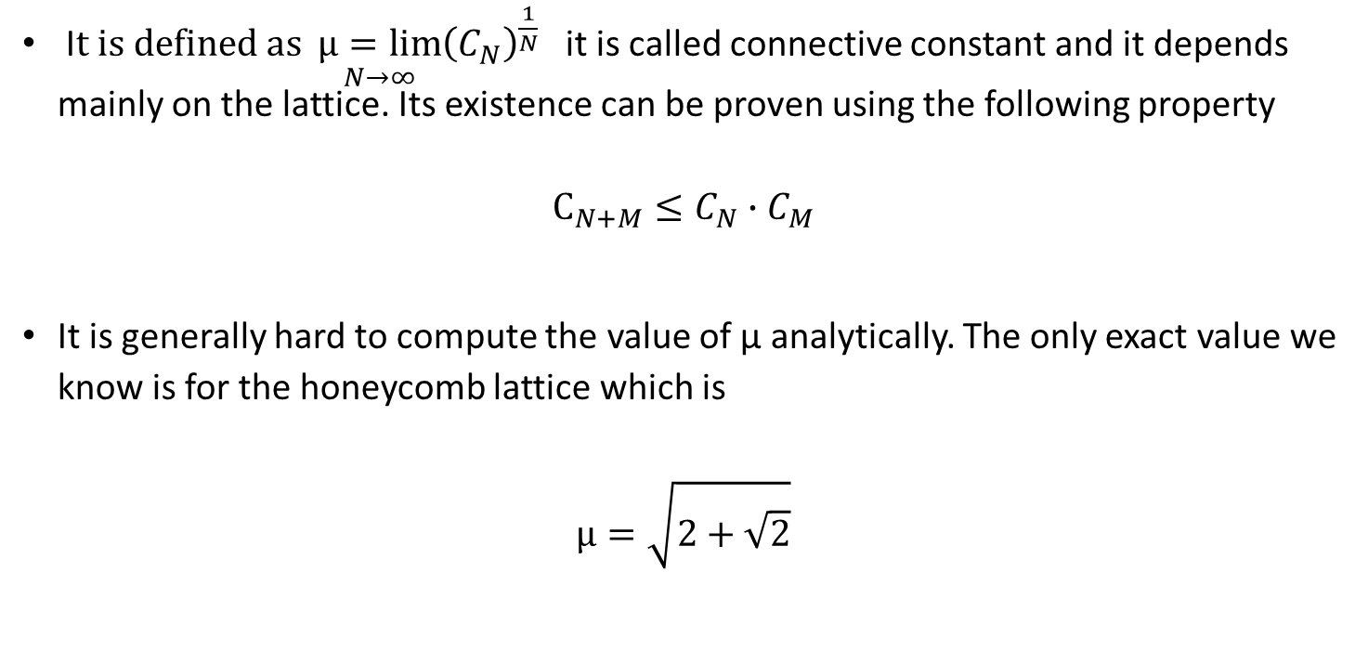
What is μ
I$t is defined as \underset{N→∞}{μ=lim}{{\left(C_{N}\right)}^{\frac{1}{N}}}$ it is called connective constant and it depends mainly on the lattice. Its existence can be proven using the following property
$$C_{N+M}≤C_{N}∙C_{M}$$
It is generally hard to compute the value of μ analytically. The only exact value we know is for the honeycomb lattice which is
$$μ=\sqrt{2+\sqrt{2}}$$

Slide 9
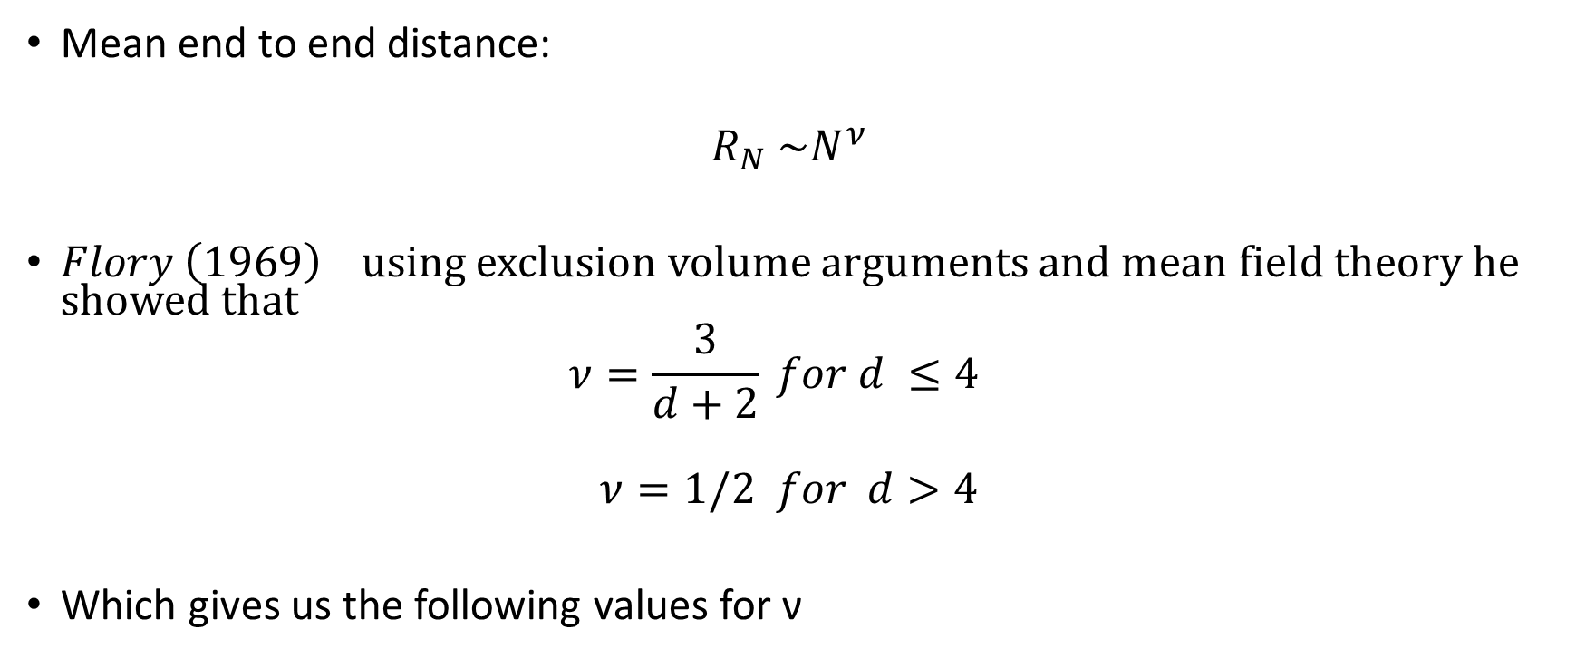
Critical Exponent ν
Mean end to end distance:
$$R_{N} \sim N^{ν}$$
$Flory \left(1969\right)$ using exclusion volume arguments and mean field theory he showed that
$$ν=\frac{3}{d+2} for d ≤4$$
$$ν=1/2 for d>4$$
Which gives us the following values for ν
d | ν
1 | 1
2 | ¾
3 | 3/5
4 | ½
>4 | ½

Slide 10
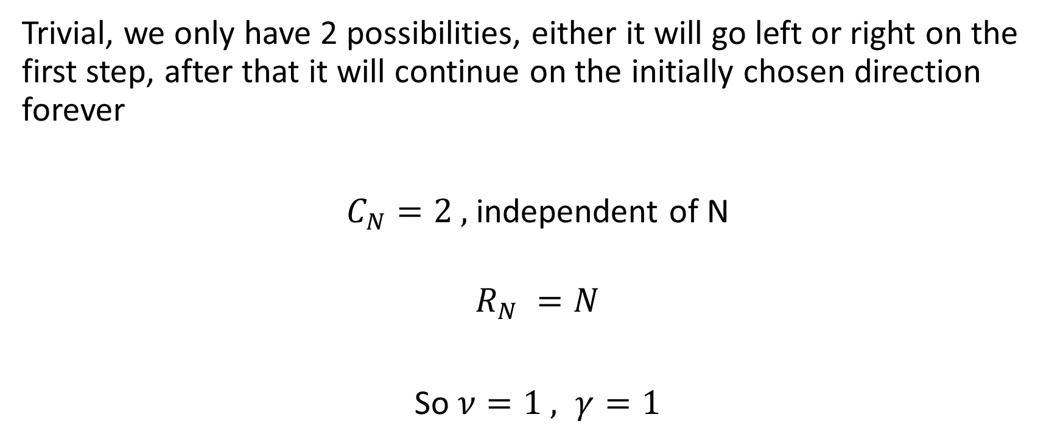

$$d = 1$$
Trivial, we only have 2 possibilities, either it will go left or right on the first step, after that it will continue on the initially chosen direction forever
$C_{N}=2 ,$ independent of N
$$R_{N} =N$$
So $ν=1 , γ=1$

Slide 11
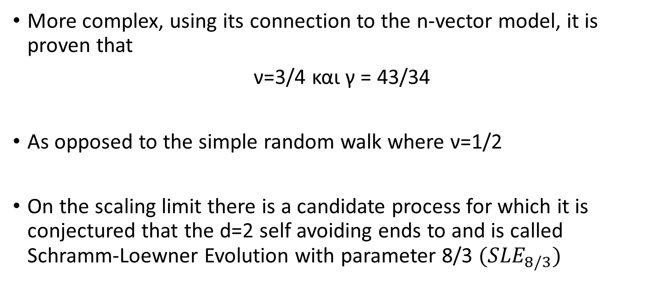

$$d = 2$$
More complex, using its connection to the n-vector model, it is proven that
ν=3/4 και γ = 43/34
As opposed to the simple random walk where ν=1/2
On the scaling limit there is a candidate process for which it is conjectured that the d=2 self avoiding ends to and is called Schramm-Loewner Evolution with parameter 8/3 ${(SLE}_{8/3})$

Slide 12
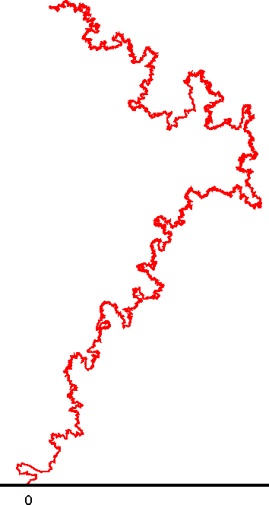

$${SLE}_{8/3}$$

Slide 13
$$d = 2$$
More complex, using its connection to the n-vector model, it is proven that
ν=3/4 και γ = 43/34
As opposed to the simple random walk where ν=1/2
On the scaling limit there is a candidate process for which it is conjectured that the d=2 self avoiding ends to and is called Schramm-Loewner Evolution with parameter 8/3 ${(SLE}_{8/3})$

Slide 14

Simple Random Walk
N= 10000
Self Avoiding Walk
N=10000

Slide 15
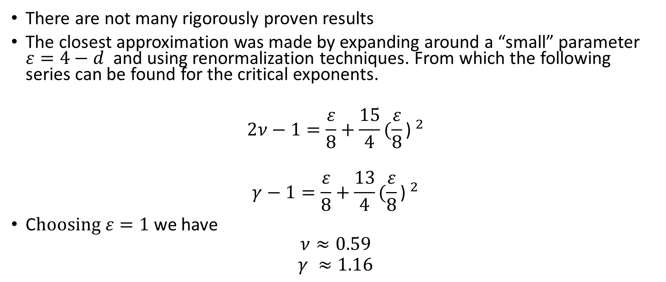

$$d=3$$
There are not many rigorously proven results
The closest approximation was made by expanding around a “small” parameter $ε=4−d$ and using renormalization techniques. From which the following series can be found for the critical exponents.
$$2ν−1=\frac{ε}{8}+\frac{15}{4}{(\frac{ε}{8}\text{) }}^{2}$$
$$γ−1=\frac{ε}{8}+\frac{13}{4}{(\frac{ε}{8}\text{) }}^{2}$$
C$hoosing ε=1$ we have
$$ν≈0.59$$
$$γ ≈1.16$$

Slide 16
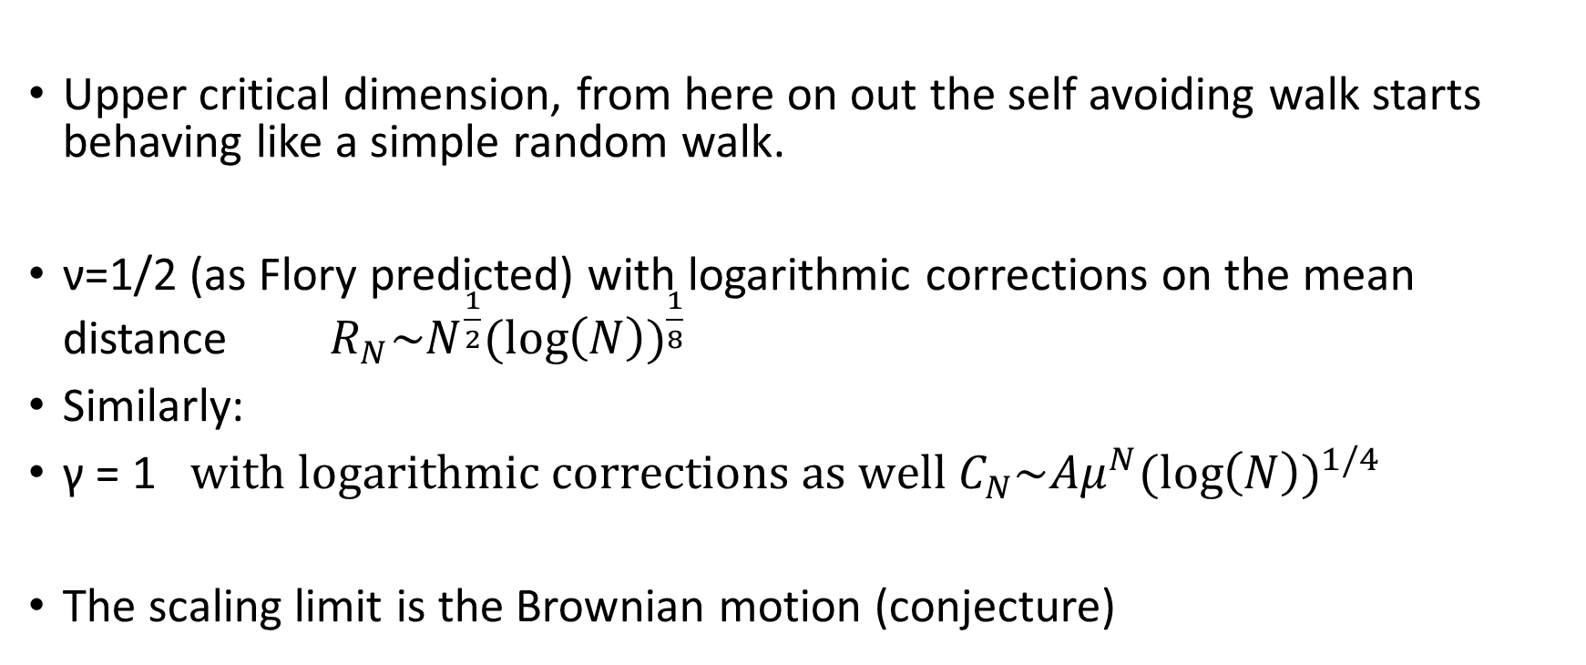

$$d=4$$
Upper critical dimension, from here on out the self avoiding walk starts behaving like a simple random walk.
ν=1/2 (as Flory predicted) with logarithmic corrections on the mean distance $R_{N}\sim N^{\frac{1}{2}}{(\log\left(N\right))}^{\frac{1}{8}}$
Similarly:
γ = 1 $with logarithmic corrections as well C_{N}\sim {Aμ}^{N}{(\log\left(N\right))}^{1/4}$
The scaling limit is the Brownian motion (conjecture)

Slide 17
X , Y components
Simple Random Walk
X , Y components
Self AvoidingWalk
Z, “W” components
Self AvoidingWalk
Z, “W” components
Simple Random Walk

Slide 18
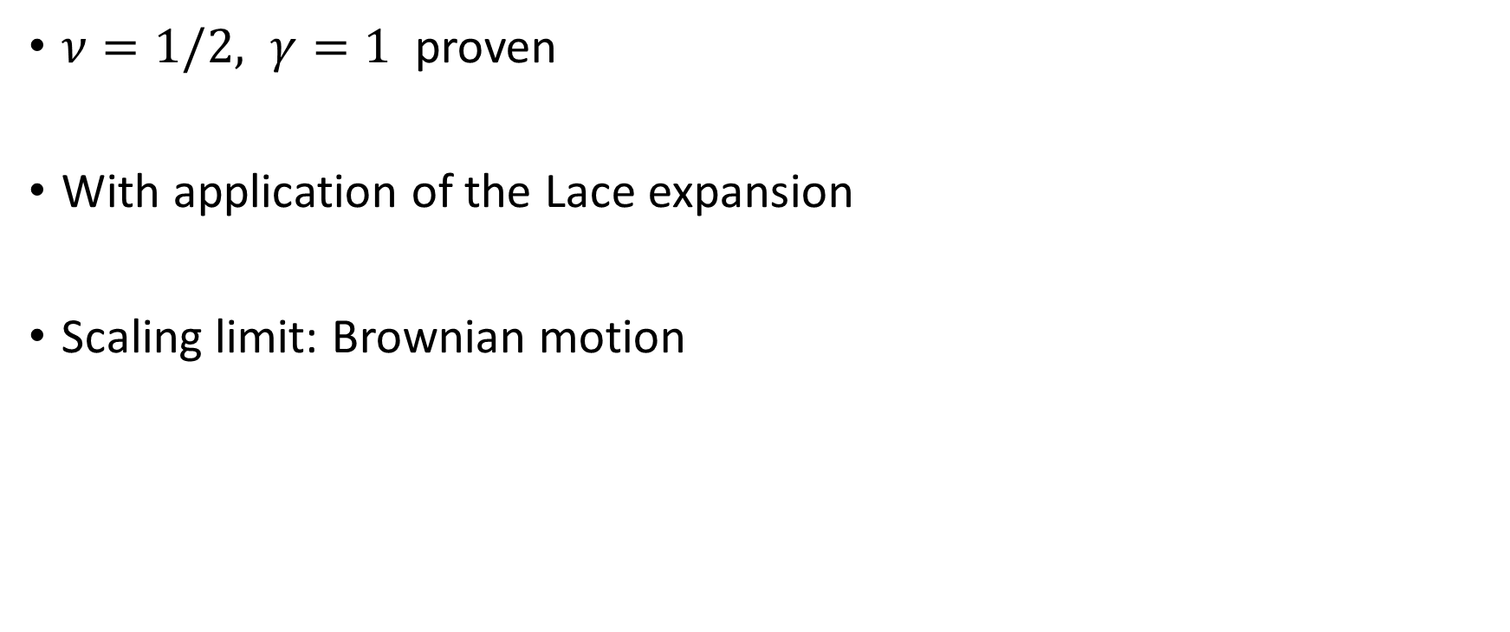

$$d>4$$
$ν=1/2, γ=1$proven
With application of the Lace expansion
Scaling limit: Brownian motion

Slide 19
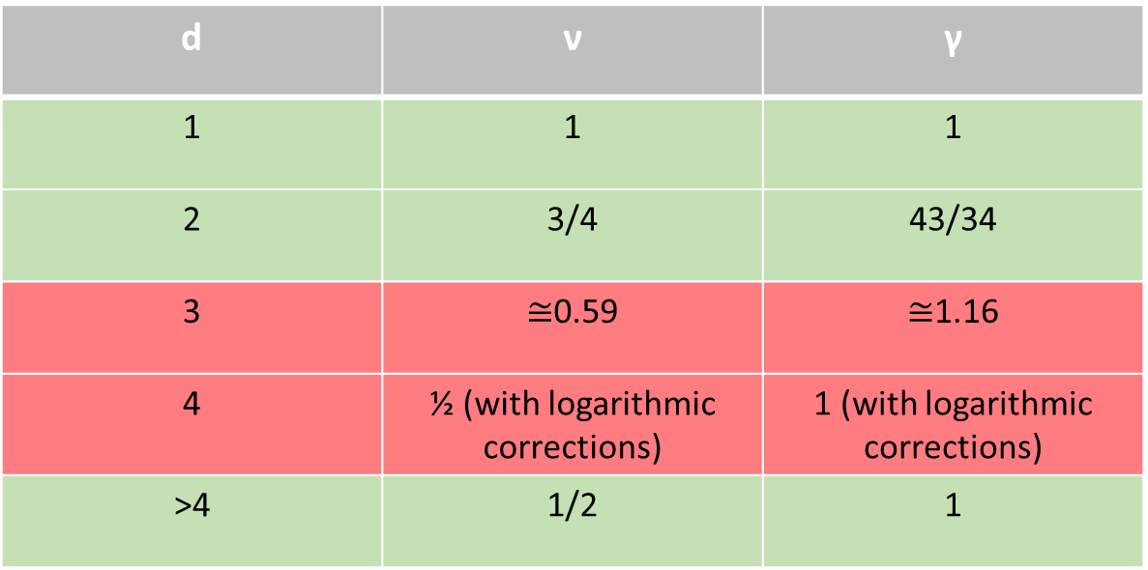
Conclusion
d | ν | γ
1 | 1 | 1
2 | 3/4 | 43/34
3 | $≅$0.59 | $≅$1.16
4 | ½ (with logarithmic corrections) | 1 (with logarithmic corrections)
>4 | 1/2 | 1

